Slide 1
Module 3 – Hypothesis Testing

Slide 2
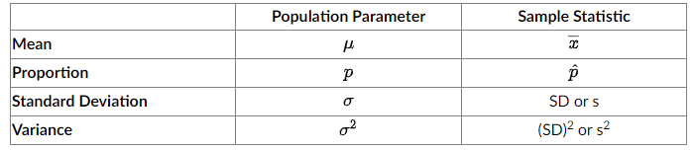
Hypothesis Testing
Hypothesis testing uses a sample statistic to make inferences about populations.
This is done by hypothesizing a value for the population parameter and comparing the sample statistic to it to see if the difference is significant.
The following table reviews the sample statistics used to test the population parameter.

Slide 3
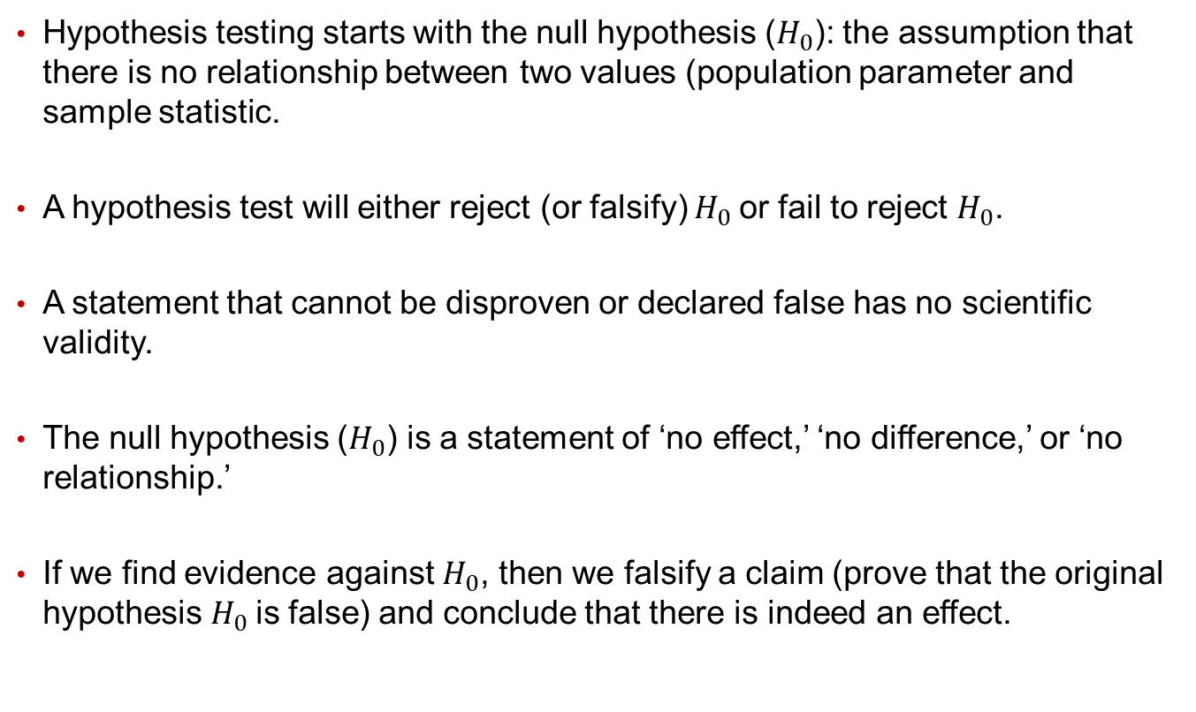
Hypothesis Testing
Hypothesis testing starts with the null hypothesis ($H_{0}$): the assumption that there is no relationship between two values (population parameter and sample statistic.
A hypothesis test will either reject (or falsify) $H_{0}$or fail to reject $H_{0}$.
A statement that cannot be disproven or declared false has no scientific validity.
The null hypothesis ($H_{0}$) is a statement of ‘no effect,’ ‘no difference,’ or ‘no relationship.’
If we find evidence against $H_{0}$, then we falsify a claim (prove that the original hypothesis $H_{0}$is false) and conclude that there is indeed an effect.

Slide 4
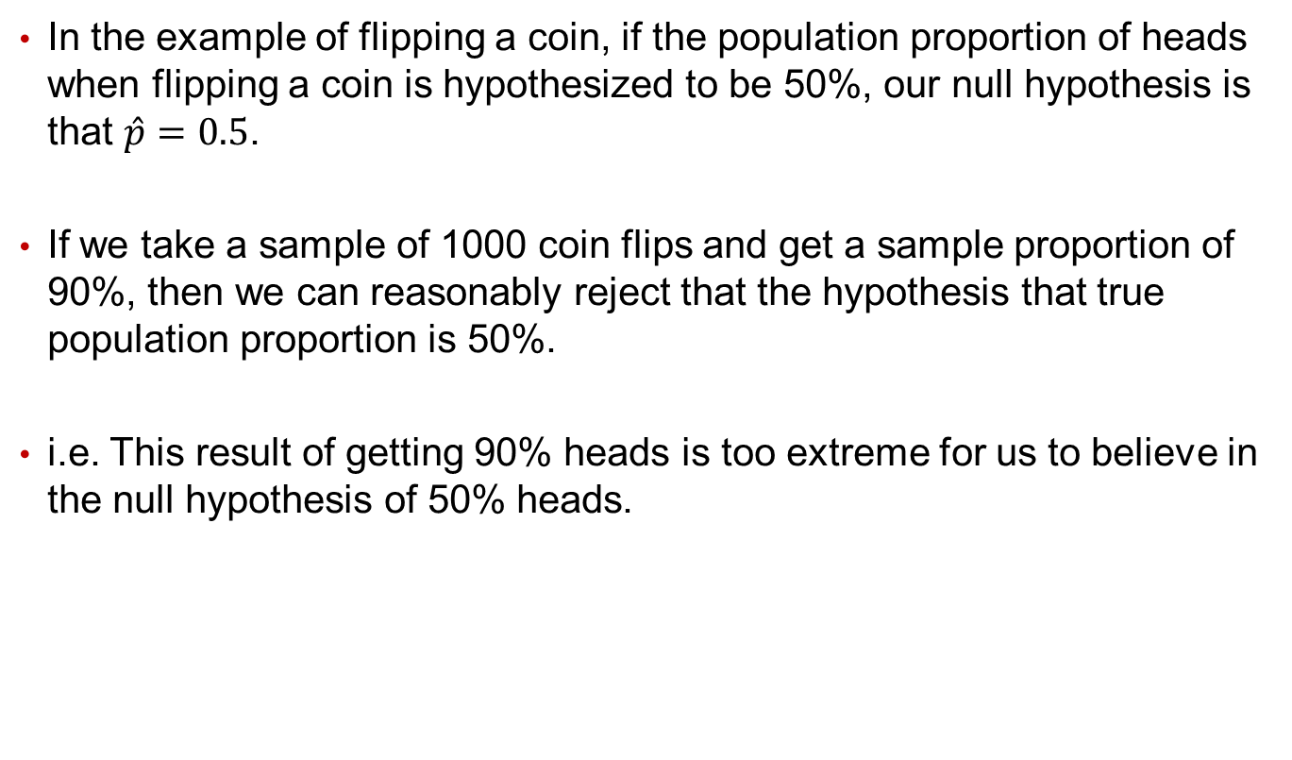
Hypothesis Testing Example
In the example of flipping a coin, if the population proportion of heads when flipping a coin is hypothesized to be 50%, our null hypothesis is that $\hat{p}=0.5$.
If we take a sample of 1000 coin flips and get a sample proportion of 90%, then we can reasonably reject that the hypothesis that true population proportion is 50%.
i.e. This result of getting 90% heads is too extreme for us to believe in the null hypothesis of 50% heads.

Slide 5
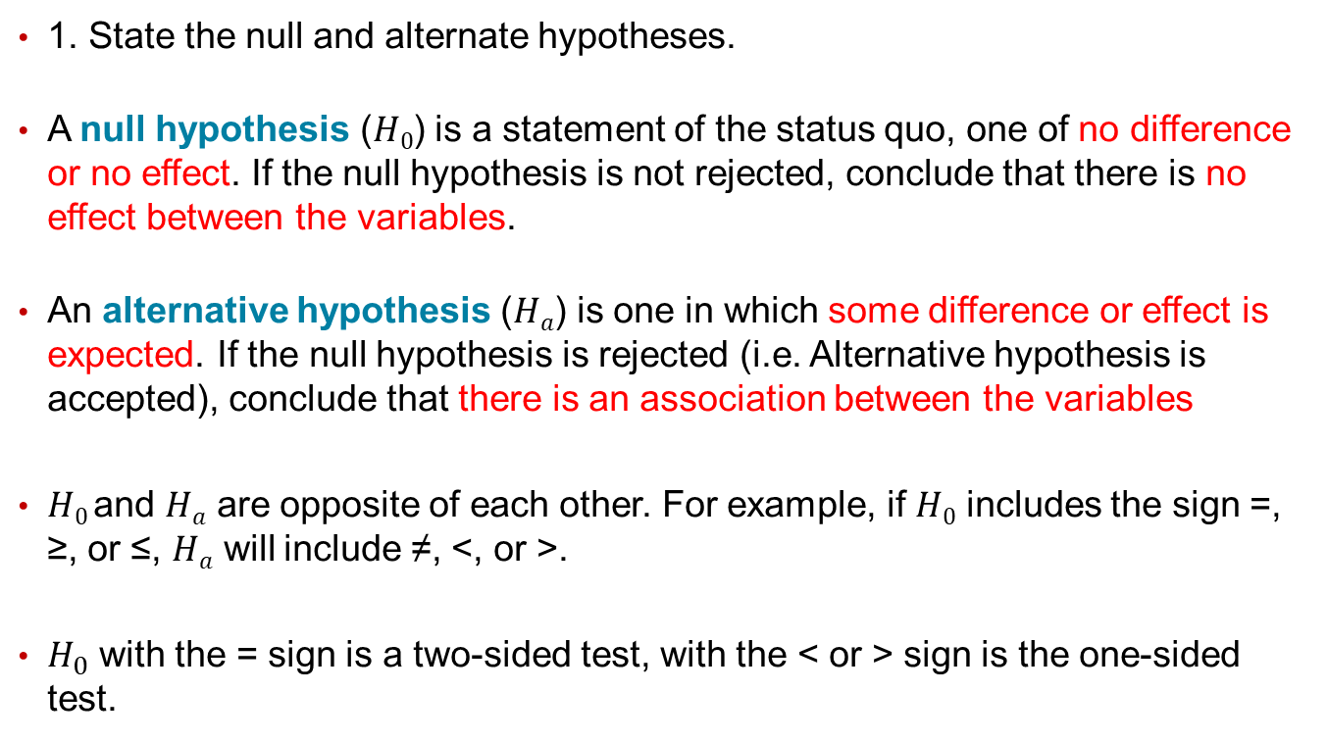
Hypothesis Testing Steps
1. State the null and alternate hypotheses.
A null hypothesis ($H0$) is a statement of the status quo, one of no difference or no effect. If the null hypothesis is not rejected, conclude that there is no effect between the variables.
An alternative hypothesis ($Ha$) is one in which some difference or effect is expected. If the null hypothesis is rejected (i.e. Alternative hypothesis is accepted), conclude that there is an association between the variables
$H0$and $Ha$ are opposite of each other. For example, if $H0$ includes the sign =, ≥, or ≤, $Ha$ will include ≠, <, or >.
$H_{0}$ with the = sign is a two-sided test, with the < or > sign is the one-sided test.

Slide 6
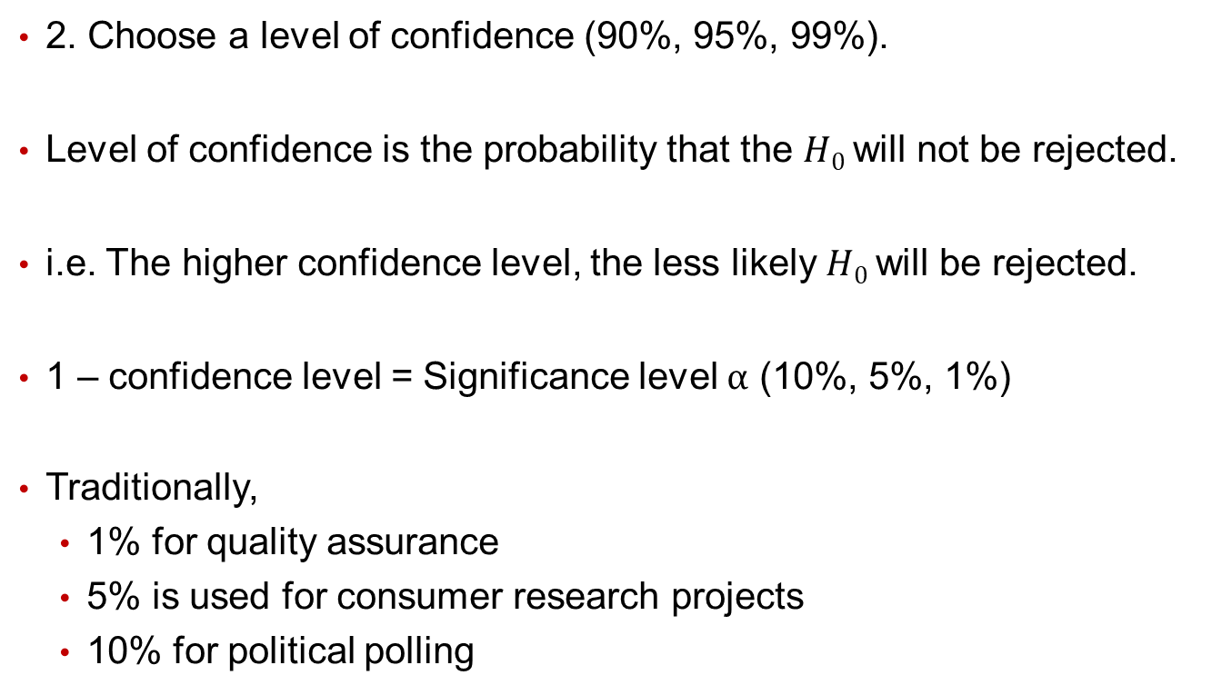
Hypothesis Testing Steps
2. Choose a level of confidence (90%, 95%, 99%).
Level of confidence is the probability that the $H0$will not be rejected.
i.e. The higher confidence level, the less likely $H0$will be rejected.
1 – confidence level = Significance level $\text{α}$ (10%, 5%, 1%)
Traditionally,
1% for quality assurance
5% is used for consumer research projects
10% for political polling

Slide 7
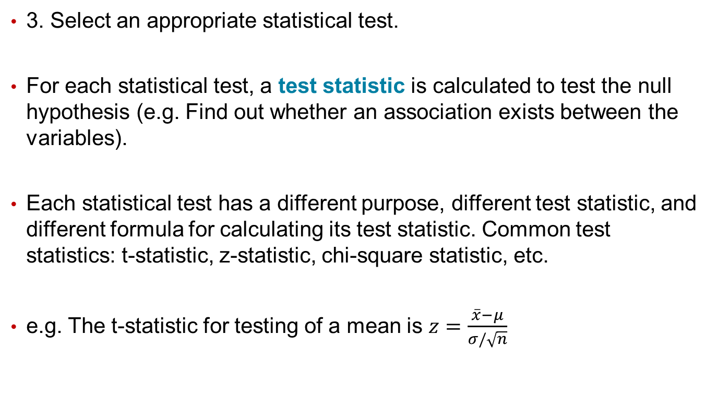
Hypothesis Testing Steps
3. Select an appropriate statistical test.
For each statistical test, a test statistic is calculated to test the null hypothesis (e.g. Find out whether an association exists between the variables).
Each statistical test has a different purpose, different test statistic, and different formula for calculating its test statistic. Common test statistics: t-statistic, z-statistic, chi-square statistic, etc.
e.g. The t-statistic for testing of a mean is $z=\frac{\overline{x}−μ}{σ/\sqrt{n}}$

Slide 8
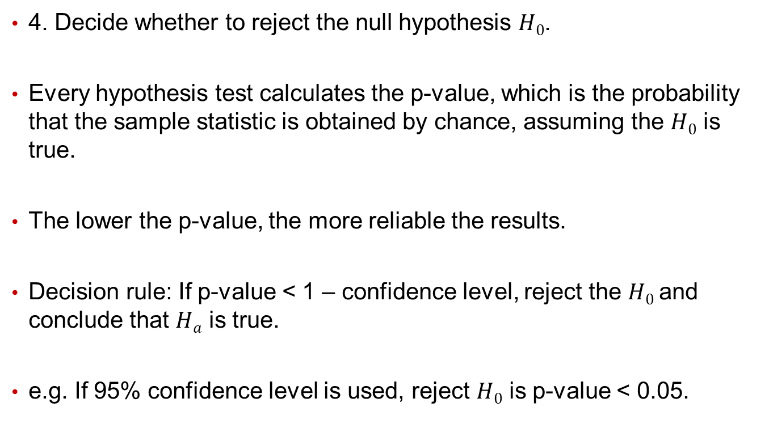
Hypothesis Testing Steps
4. Decide whether to reject the null hypothesis $H0$.
Every hypothesis test calculates the p-value, which is the probability that the sample statistic is obtained by chance, assuming the $H0$ is true.
The lower the p-value, the more reliable the results.
Decision rule: If p-value < 1 – confidence level, reject the $H0$and conclude that $Ha$ is true.
e.g. If 95% confidence level is used, reject $H0$ is p-value < 0.05.

Slide 9
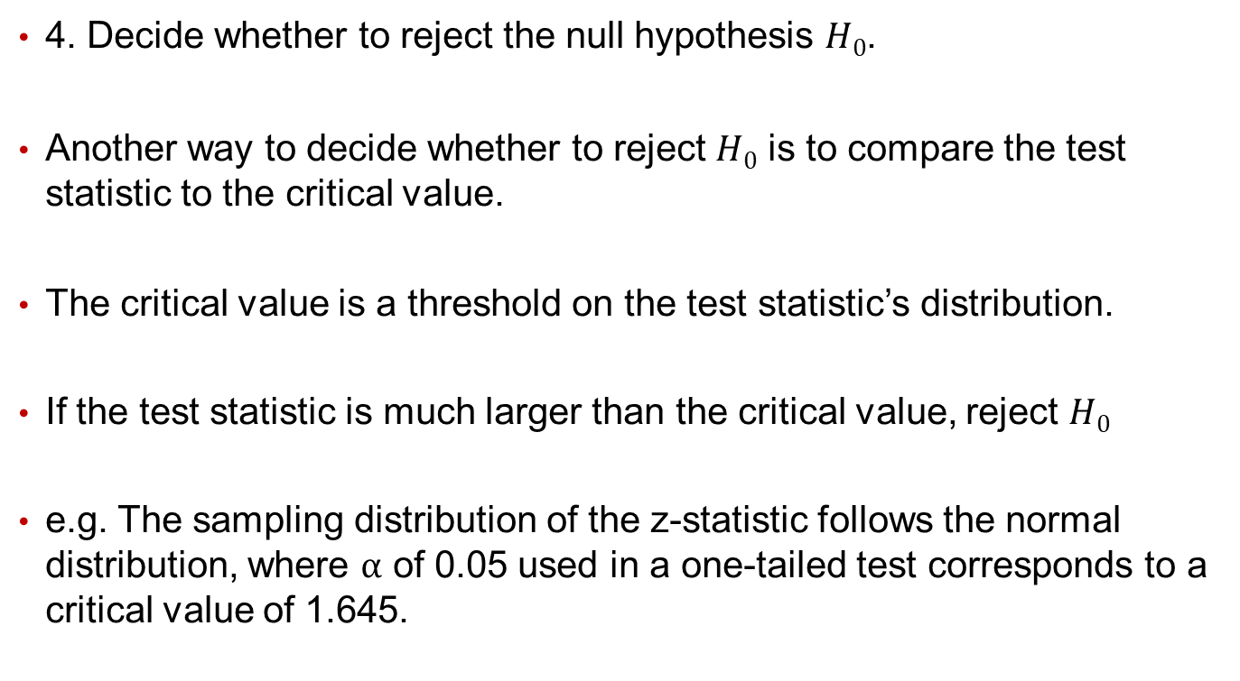
Hypothesis Testing Steps
4. Decide whether to reject the null hypothesis $H0$.
Another way to decide whether to reject $H0$ is to compare the test statistic to the critical value.
The critical value is a threshold on the test statistic’s distribution.
If the test statistic is much larger than the critical value, reject $H0$
e.g. The sampling distribution of the z-statistic follows the normal distribution, where $\text{α}$ of 0.05 used in a one-tailed test corresponds to a critical value of 1.645.

Slide 10
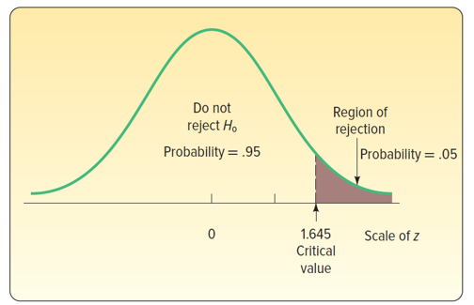

Hypothesis Testing Steps
4. Decide whether to reject the null hypothesis $H0$.
In this case, any test statistic > 1.645 will reject $H0$ (this is a one-sided test, and more specifically a right-tailed test).

Slide 11
One Sample T-Test for Means
Purpose: In data analytics, the researcher is often interested in comparing an average value of a variable to a number.
Examples of such statements include the following:
The market share for a new product will exceed 15 percent
At least 65 percent of customers will like a new package design; 80 percent of dealers will prefer the new pricing policy.
These statements can be translated to null hypotheses that can be tested using a one-sample t-test.

Slide 12
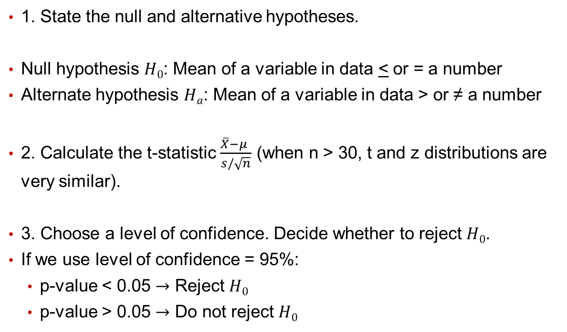
One Sample T-Test for Means
1. State the null and alternative hypotheses.
Null hypothesis $H0$: Mean of a variable in data < or = a number
Alternate hypothesis $Ha$: Mean of a variable in data > or ≠ a number
2. Calculate the t-statistic $\frac{\overline{X}−μ }{s/\sqrt{n}}$ (when n > 30, t and z distributions are very similar).
3. Choose a level of confidence. Decide whether to reject $H0$.
If we use level of confidence = 95%:
p-value < 0.05 $→$ Reject $H0$
p-value > 0.05 $→$ Do not reject $H0$

Slide 13
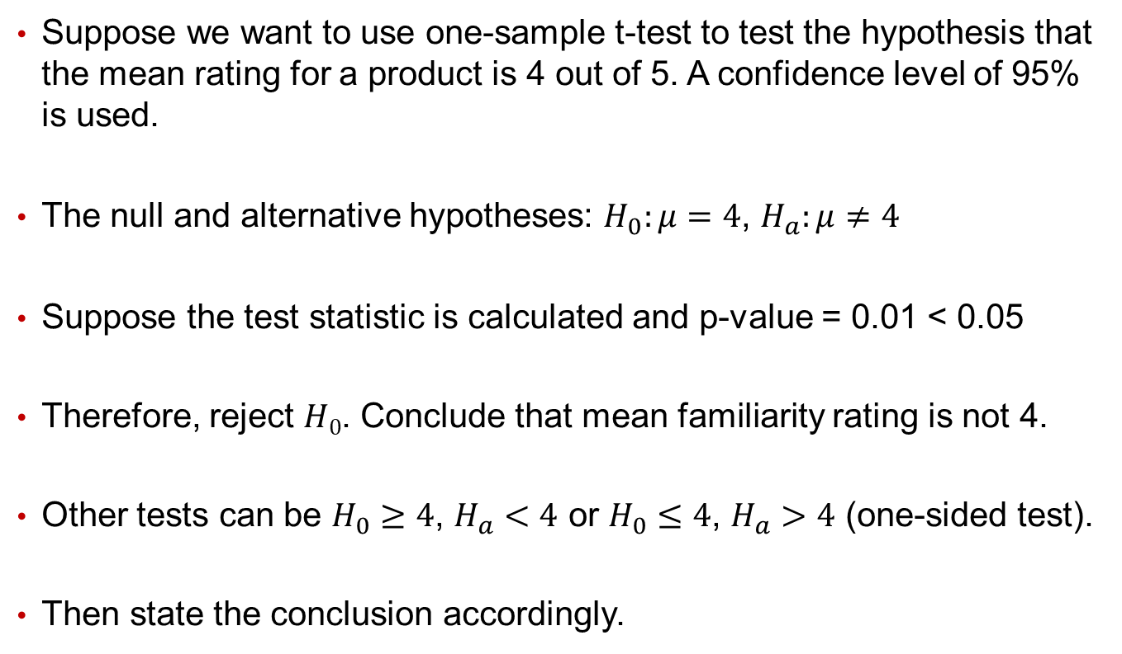
Example: One Sample T-Test for Means
Suppose we want to use one-sample t-test to test the hypothesis that the mean rating for a product is 4 out of 5. A confidence level of 95% is used.
The null and alternative hypotheses: $H_{0}:μ=4$, $H_{a}:μ≠4$
Suppose the test statistic is calculated and p-value = 0.01 < 0.05
Therefore, reject $H0$. Conclude that mean familiarity rating is not 4.
Other tests can be $H_{0}≥4$, $H_{a}<4$ or $H_{0}≤4$, $H_{a}>4$ (one-sided test).
Then state the conclusion accordingly.

Slide 14
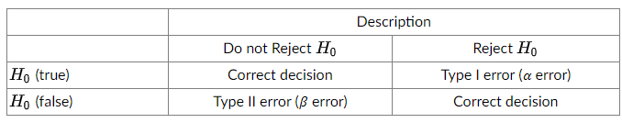
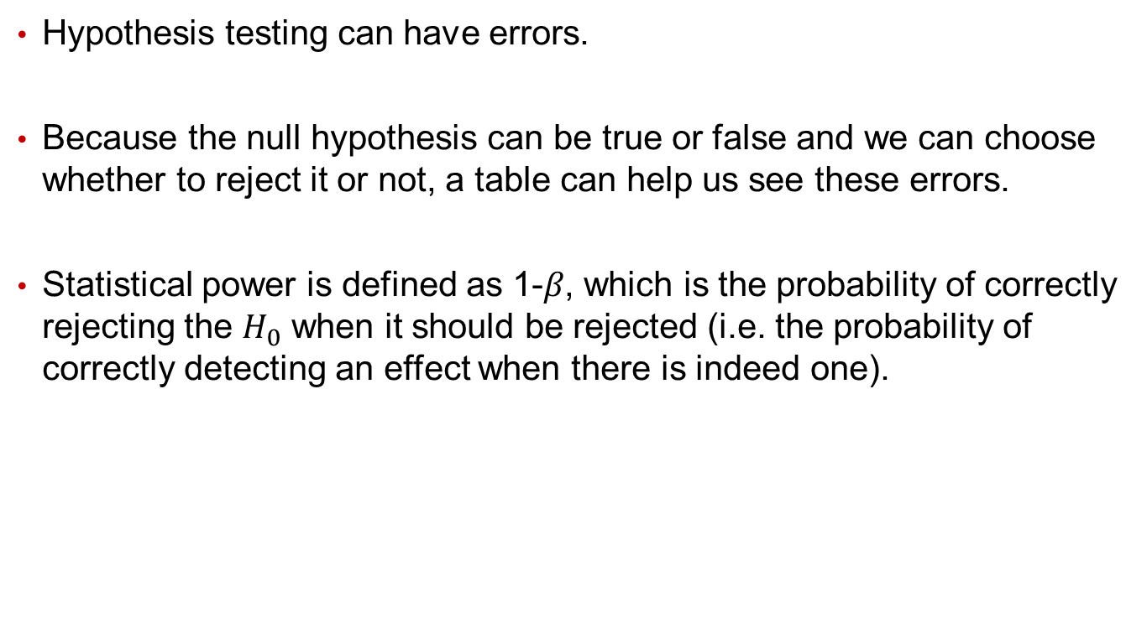
Type I and Type II Errors
Hypothesis testing can have errors.
Because the null hypothesis can be true or false and we can choose whether to reject it or not, a table can help us see these errors.
Statistical power is defined as 1-𝛽, which is the probability of correctly rejecting the $H_{0}$ when it should be rejected (i.e. the probability of correctly detecting an effect when there is indeed one).

Slide 15
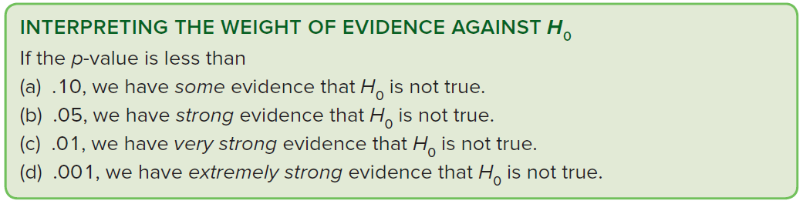

More on P-Value
P-value is the probability of observing an extreme sample statistic, given that $H0$ is true. Intuitively, it is the probability of getting the results by chance (lower p-value $→$ more reliable results).
Compare the p-value with the level of significance $α$
If the p-value is smaller than $α$, reject $H0$. Otherwise, $H0$ is not rejected.
A p-value not only results in a decision about $H0$, but gives additional insight about the strength of that decision.

Slide 16
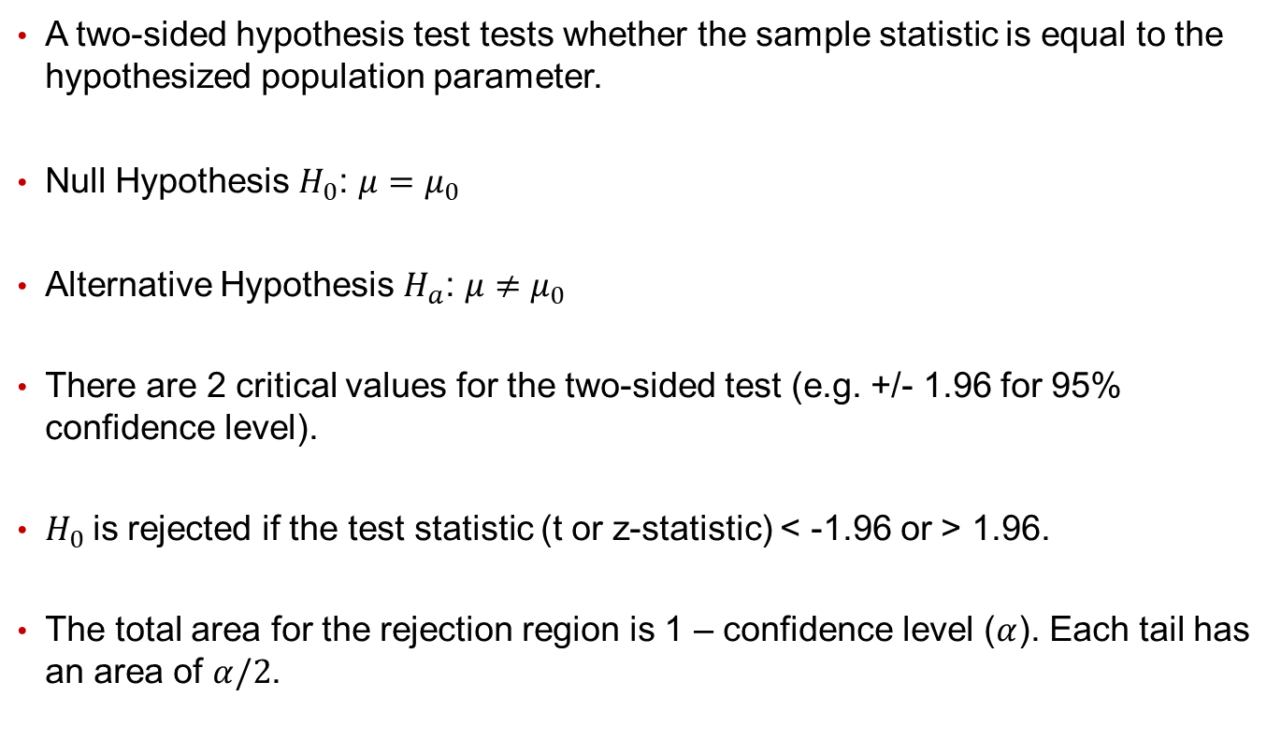
Appendix: One-Sided vs. Two-Sided Tests
A two-sided hypothesis test tests whether the sample statistic is equal to the hypothesized population parameter.
Null Hypothesis $H_{0}$: $μ=μ_{0}$
Alternative Hypothesis $H_{a}$: $μ≠μ_{0}$
There are 2 critical values for the two-sided test (e.g. +/- 1.96 for 95% confidence level).
$H_{0}$is rejected if the test statistic (t or z-statistic) < -1.96 or > 1.96.
The total area for the rejection region is 1 – confidence level ($α$). Each tail has an area of $α/2$.

Slide 17
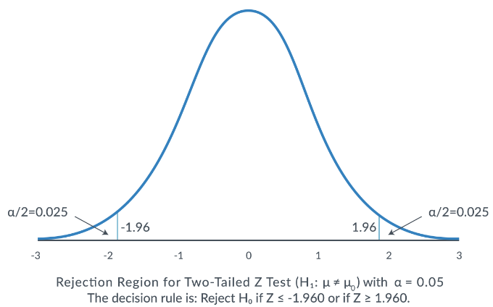
Appendix: One-Sided vs. Two-Sided Tests

Slide 18
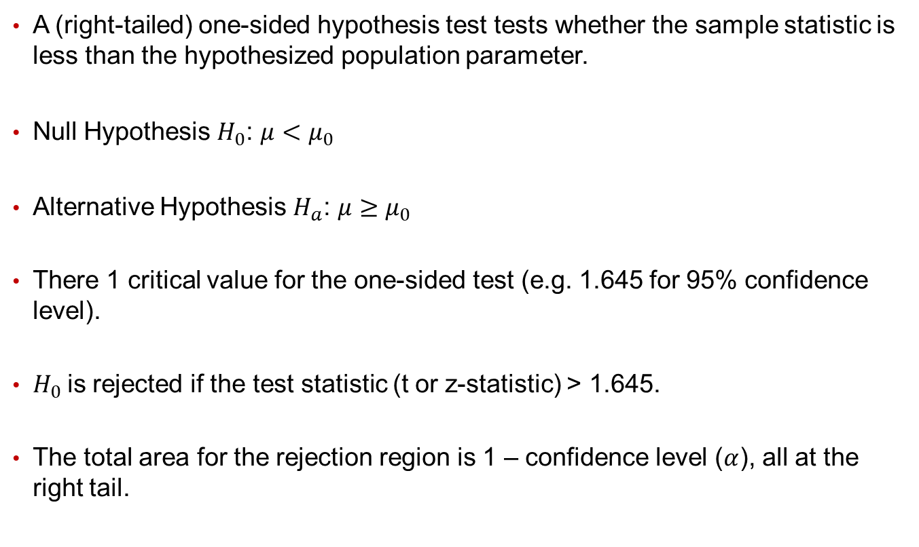
Appendix: One-Sided vs. Two-Sided Tests
A (right-tailed) one-sided hypothesis test tests whether the sample statistic is less than the hypothesized population parameter.
Null Hypothesis $H_{0}$: $μ<μ_{0}$
Alternative Hypothesis $H_{a}$: $μ≥μ_{0}$
There 1 critical value for the one-sided test (e.g. 1.645 for 95% confidence level).
$H_{0}$is rejected if the test statistic (t or z-statistic) > 1.645.
The total area for the rejection region is 1 – confidence level ($α$), all at the right tail.

Slide 19
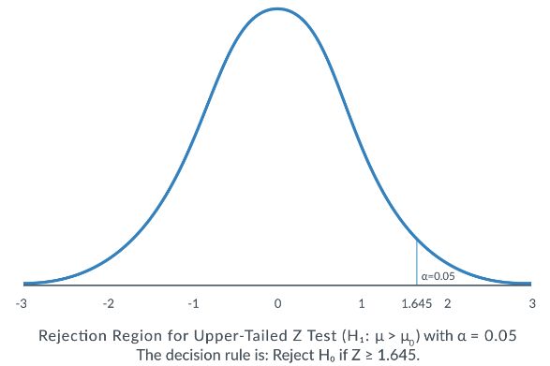
Appendix: One-Sided vs. Two-Sided Tests

Slide 20
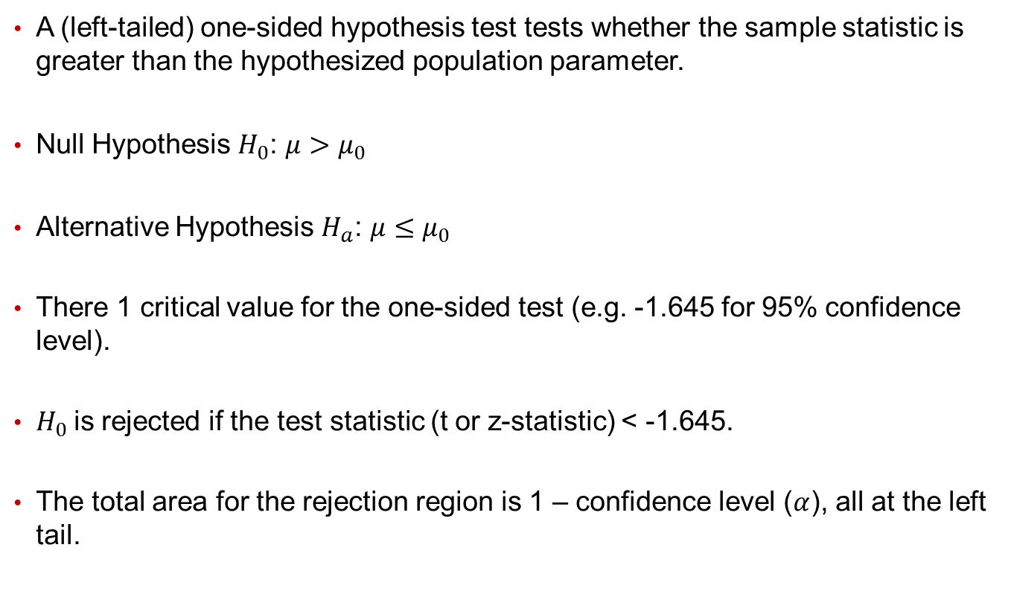
Appendix: One-Sided vs. Two-Sided Tests
A (left-tailed) one-sided hypothesis test tests whether the sample statistic is greater than the hypothesized population parameter.
Null Hypothesis $H_{0}$: $μ>μ_{0}$
Alternative Hypothesis $H_{a}$: $μ≤μ_{0}$
There 1 critical value for the one-sided test (e.g. -1.645 for 95% confidence level).
$H_{0}$is rejected if the test statistic (t or z-statistic) < -1.645.
The total area for the rejection region is 1 – confidence level ($α$), all at the left tail.

Slide 21
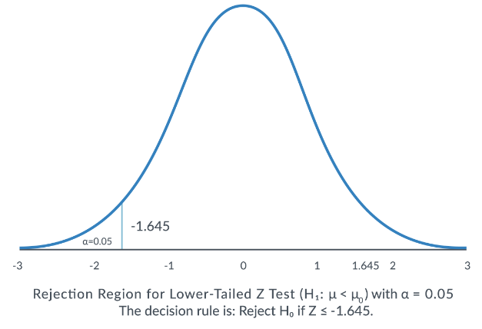
Appendix: One-Sided vs. Two-Sided Tests

